Slide 1
Preprocessing Part 2
OPIM 5604 – Predictive Modeling
Jennifer Eigo

Slide 2
Module Topics
Cleaning data
Changing variable data types
Handling missing values
Handling outliers
Standardizing data
Transforming data
Data Reduction
Categorical reduction
Principal components analysis (PCA)

Slide 3
Cleaning the Data

Slide 4
Variable Data Type Changes
Check for numeric variables that are actually categorical in nature
Examples include zip code, month, binary indicators, any number that is code for a category, etc.

Slide 5
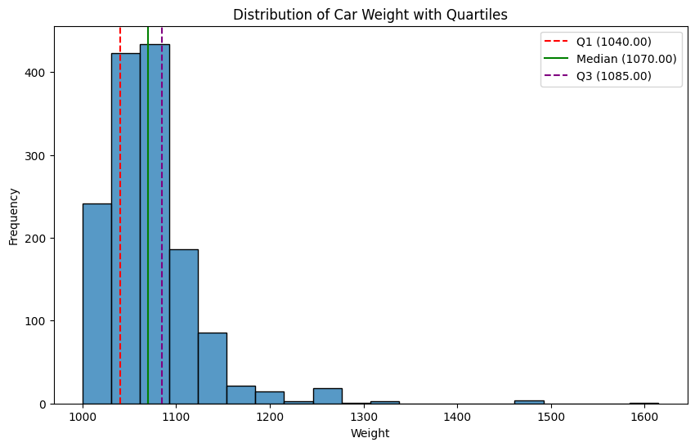
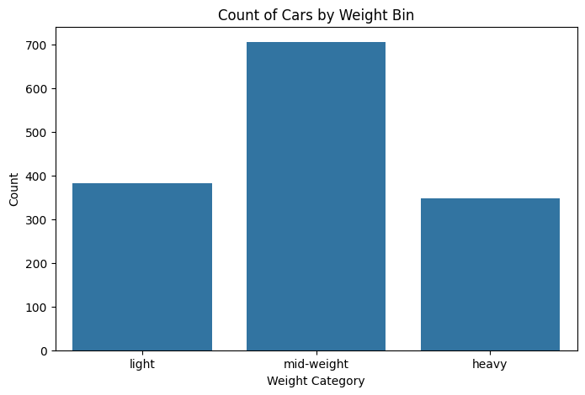
Variable Data Type Changes
Numeric to categorical
Most algorithms can handle numeric data
May occasionally need to “bin” into categories
Example – Convert Weight into ranges

Slide 6
Variable Data Type Changes
Categorical to numeric
Some packages or software require conversion to binary dummy or indicator variables
Number of dummies = number of categories – 1
Also called one-hot encoding
Example – Convert three fuel categories into two new indicator columns
Fuel_Type | Diesel | Petrol
Diesel | 1 | 0
Petrol | 0 | 1
CNG | 0 | 0

Slide 7
Handling Missing Data
Most algorithms will either fail to run or will exclude missing data by default
Solution 1: Omission
If a small number of records have missing values, can drop them from your analysis
If many records are missing values on a small set of variables, can drop those variables
If many records have missing values, omission is not practical
Solution 2: Imputation
Replace missing values with reasonable substitutes
Lets you keep the record and use the rest of its (non-missing) information

Slide 8
Handling Outliers
Outliers can skew results of some analyses
Solution 1: Omission
If a small number of records have extreme values, can drop them from your analysis
Solution 2: Correction
Replace extreme values with reasonable substitutes
This is only practical in cases where it looks like a typo
Example – An age of 400 could probably be updated to 40
Solution 3: Do nothing
If the potential outlier is realistic and not too distant, you can try your analysis with the outlier included
Solution 4: Transform

Slide 9
Standardizing Data
Used in some techniques when variables with the largest scales would dominate and skew results
Puts all variables on same or similar scale
Standardizing function: Subtract mean and divide by standard deviation
Same as Z-score
Alternate function: Scale to 0-1 by subtracting minimum and dividing by the range
Useful when the data contain dummies and numeric

Slide 10
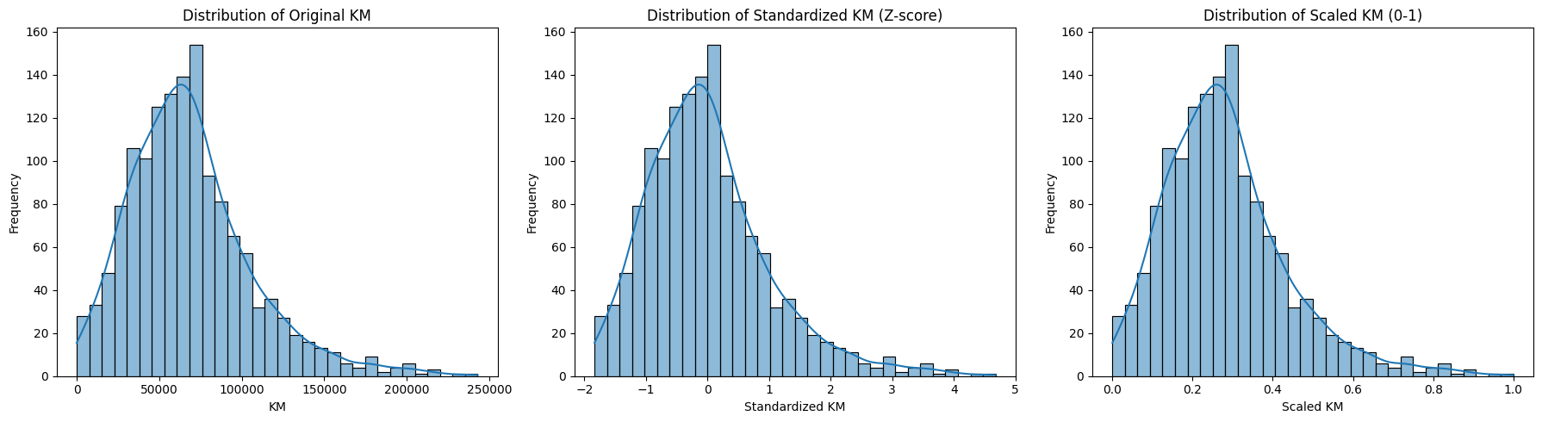
Standardizing Data
Note that the shape of the distribution didn’t change.
Only the scale changes.
For the Z-scores, the mean of the distribution is now 0 and the standard deviation is now 1.
For the 0-1 scale, all the new values fall within that range.

Slide 11
Variable Transformation
When the data is very skewed it can look like there are tons of outliers
In this case, instead of omitting tons of data, we can transform the distribution
This maintains the order of values, but changes the spread of the data
Transforming gets the data closer to a normal distribution which some models require

Slide 12
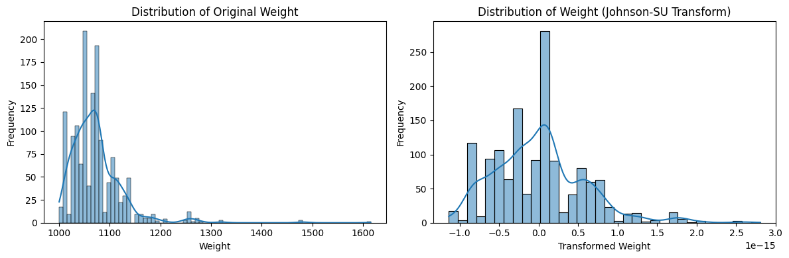
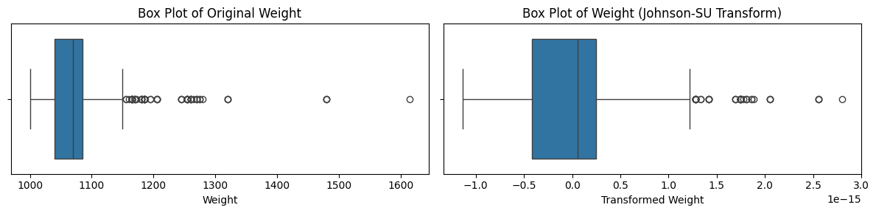
Old and New Distributions

Slide 13
Standardization vs Transform
Standardization doesn’t change the shape of the distribution, it only changes the scale
Transforming a variable changes both the scale and the shape of the distribution

Slide 14
Data Reduction

Slide 15
Data Reduction
Too many rows
Computational burden
Choose a sample
Too many variables
Redundant information
Curse of dimensionality
Model complexity

Slide 16
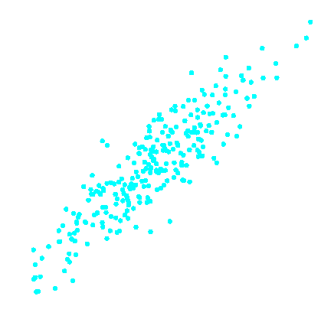
Redundant Information
Redundancy
As X₁ increases, X₂ also increases
Both variables have the same information to contribute to a model
x₂
x₁

Slide 17
The Curse of Dimensionality
1–D
2–D
Each picture has 8 points
As dimensions increase, the dataspace that the points occupy increases and becomes more sparse
This makes accurate predictions harder
3–D

Slide 18
Model Complexity
Good rule of thumb: at least 10 records for each predictor variable
Too many variables → Model is too complex → Model does not work well on new data
Too few variables → Not enough predictive power
Too complex
Not complex enough

Slide 19
Data Reduction
Reducing categorical variables
Use data exploration to assist in decisions
Reducing continuous variables
Principal Components Analysis (PCA)

Slide 20
Reducing Categories
A single categorical variable with m categories can be transformed into m-1 dummy variables
Each dummy variable takes the values 0 or 1
0 = “no” for the category
1 = “yes”
Problem: Can end up with too many variables
Solution: Reduce by combining categories that are close to each other
Use tabulations to assess outcome variable sensitivity to the dummies

Slide 21
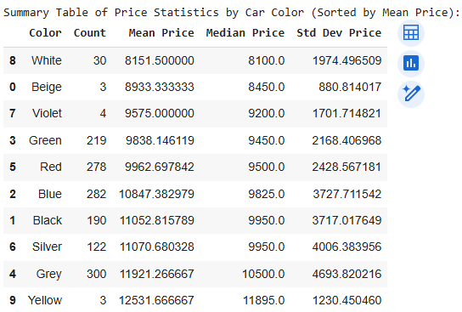
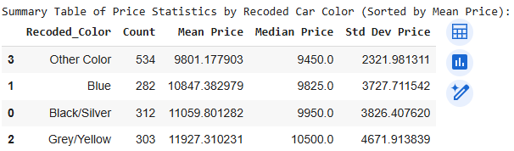
Combining Categories
There are 10 car colors which results in 9 dummy variables
If colors are similar relative to price, we can combine them
Before: After:
Now we have just 4 categories which is simpler without much information loss

Slide 22
Principal Components Analysis (PCA)
Goal: Reduce a set of numerical variables.
The idea: Remove the overlap of information between these variables. (“Information” is measured by the sum of the variances of the variables.)
Final product: Create a smaller number of numerical variables that contain most of the information.

Slide 23
How does PCA do this?
Create new variables that are linear combinations of the original variables (i.e., they are weighted averages of the original variables).
These linear combinations are uncorrelated to each other (no information overlap), and only a few of them contain most of the original information.
The new variables are called principal components.
Create the same number of principal components as the number of original variables we start with
Only use a reduced set of principal components that capture “enough” information

Slide 24
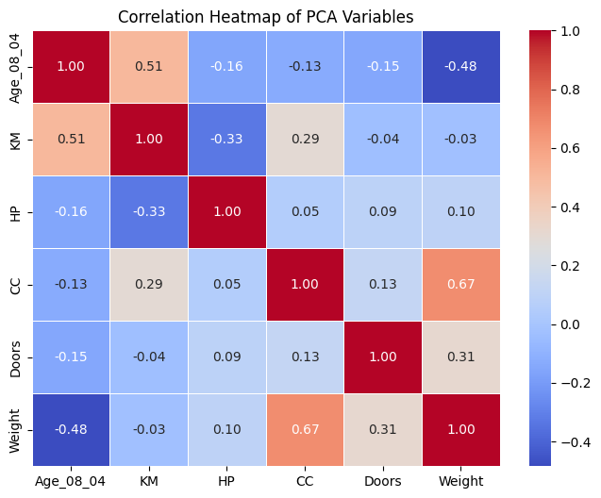
Correlations of Numeric Variables

Slide 25
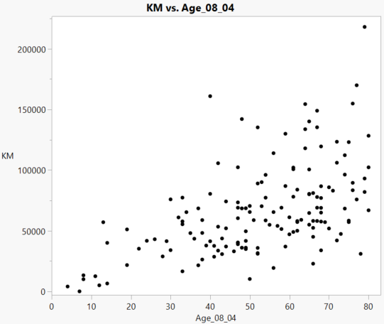
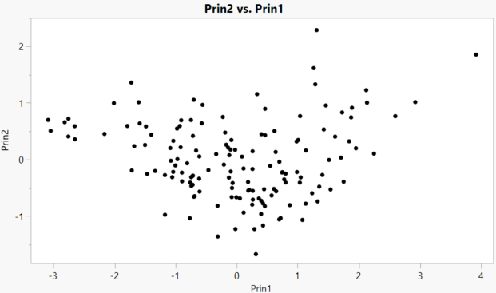
Small PCA Example – 2 Variables
PC1 gets formed across the dimension of the dataspace with the most variance. PC2 gets formed across the next most variance, perpendicular to PC1.
This is a rotation of the axis through the dataspace.
PC2
PC1

Slide 26
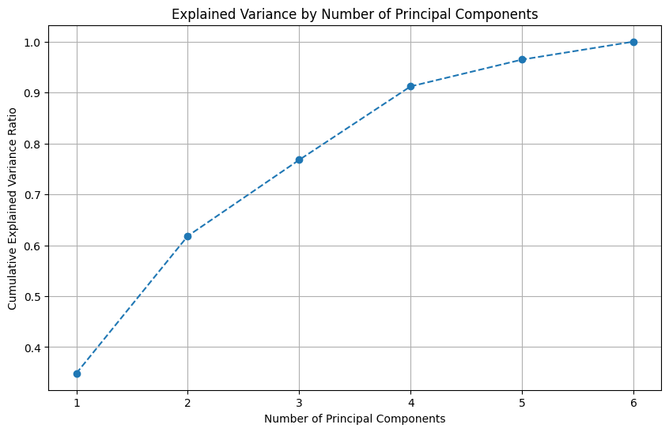
Eigenvalues
Perform PCA on Age_08_04, KM, HP, CC, Doors, and Weight
The first four principal components account for over 90% of total variance

Slide 27
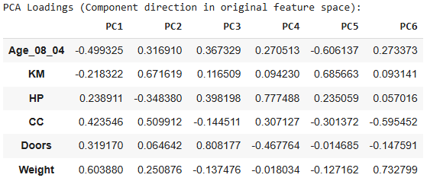
Eigenvectors
Look at the Eigenvectors (loadings) to see what variables go into each Principal Component
The further from zero, the bigger the contribution of the variable
The sign gives the direction of the relationship

Slide 28
PCA in Classification/Prediction
Apply PCA to training data only
Only input predictor variables (don’t include target!)
Decide how many PCs to use
Use variable weights in those PCs with validation/new data (calculate principal components as new features in the data table)
This creates a new reduced set of predictors in both training and validation
Saved formulas can be applied to new data prior to being scored by a model
Drawback – interpretation of variable impact is harder

Slide 29
Summary
Modifying data gets it ready for modeling
Check that data types are correct
Address missing values to avoid default handling
Address outliers to avoid extreme values skewing your analysis
Standardize and/or transform data as needed
Use data reduction techniques to simplify the size of the data space
PCA creates a new reduced set of features that remove overlap in information

